Slide 1



The condor cluster
An exploratory tech-talk

Slide 2
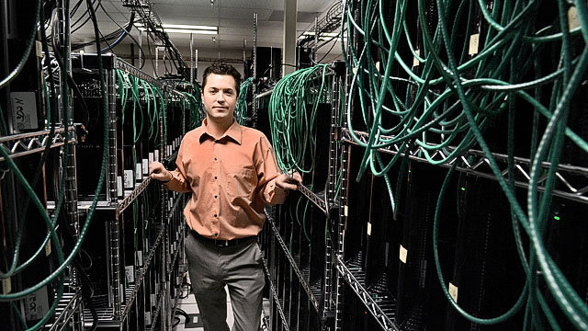
November 2010 : birth of the condor cluster
Air Force Research Laboratory creates a powerful supercomputer.
1, 760 PlayStation’s 3 are interconnected and share resources.
Fastest interactive computer system in the entire Department of Defense (U.S.A) used for analyze high-definition satellite imagery.

Slide 3
THE Supercomputer and IT’s usage
Class of extremely powerful computers.
They are the fastest high-performance systems available at any given time.
Primarily used for scientific and engineering work requiring exceedingly high-speed computations.
Common applications for supercomputers include testing mathematical models for complex physical phenomena, such as the climate and weather, the evolution of the universe, nuclear technology, testing new chemical compounds (especially for pharmaceutical purposes), cryptology and such forth.
High cost and high energy consumption.

Slide 4
Distinguishing features
Multiple CPU which contain circuits for interpreting program instructions
Use of several CPUs to achieve high computational power is necessitated by the physical limits of circuit technology
Very large storage capacity leads to rapid retrieval of stored data and instructions which are required to support the extremely high computational speed of CPUs.
Advanced cooling systems

Slide 5
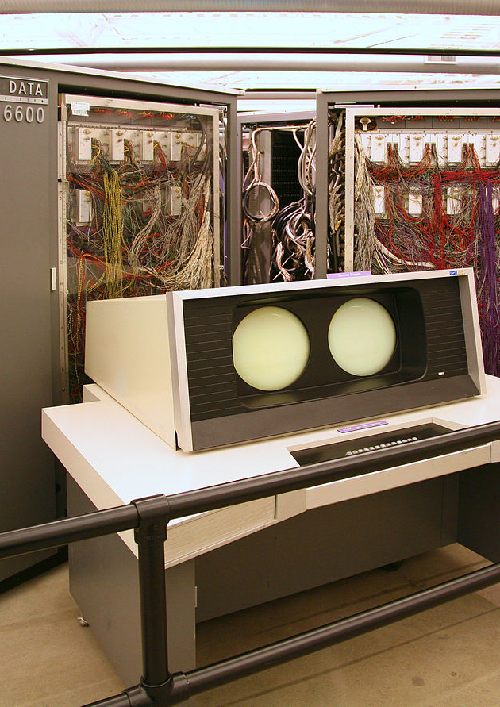
Historical development (1964)
Seymour Cray
The first supercomputer, the Control Data Corporation (CDC) 6600, only had a single CPU.
The Cray 2 is notable for being the first supercomputer to run “mainstream” software, thanks to UnicOS, a Unix System derivative with some BSD features.
Cray supercomputers had only really been used by US governmental agencies like the DoE and DoD for nuclear modeling, but the Cray 2 found a home in many universities and corporations.

Slide 6
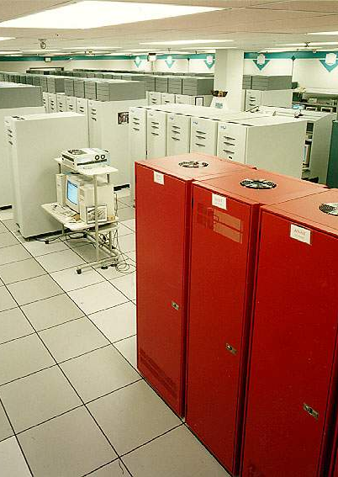
ASCI RED (1996)
Main reason for this is that supercomputers and PCs are generally at odds with each other: where supers want as much processing power as possible, PCs have lots of cost and heat constraints. For the most part, it just didn’t make sense to use Intel chips in early supercomputers.
Paragon was a commercial failure, but it led to the creation of ASCI Red in 1996, which was the first supercomputer made from off-the-shelf CPUs.
ASCI Red, with over 6,000 200MHz Pentium Pros and a cost of $46 million ($67 million today), was the first supercomputer to break the 1 teraflop barrier.
Later upgraded to 9,298 Pentium II Xeons, ASCI Red reached 3.1 teraflops.
It was the fastest supercomputer in the world for four years.

Slide 7
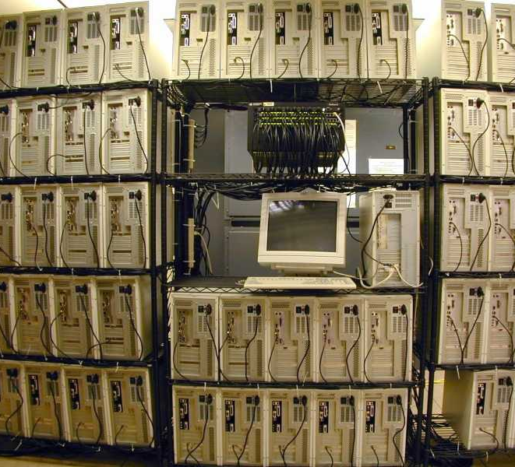
Beowulf clusters
Cluster: networks with any number of commodity PCs, generally running Linux — quickly emerged, and Linux soon replaced Unix as the supercomputing OS of choice.
Open-Source OS saves cost and is customizable.

Slide 8
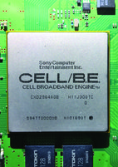
PlayStation 3 - CELL
Sony PS3 allows the Linux operating system to be installed, and IBM designed the programming environment for programming the Cell processor which combined tremendous computing power within a single PS3.
STI Alliance to create CELL.
Use of tech in various fields : medical, televisions, gaming, industry.
IBM’s Roadrunner.
Dr. Frank Mueller cluster of eight Sony PS3 machines — the first such academic cluster in the world — packs the power of a small supercomputer, but at a total cost of about $5,000, it costs less than some desktop computers that have only a fraction of the computing power.

